Slide 1
Lecture 4
Classification

Slide 2
Problem Description
Inputs: (feature space)
Labels: (classes)
Classifier
e.g. x^{k} are planets
= [size , density]
terrestrial planets
Me
Ma
E
decision boundary
p
V
X
density
gas giants
U
N
S
J
size
The task for the classifier is to determine the optimal decision boundary

Slide 3
Problem Description
Inputs: (feature space)
Labels: (classes)
Classifier
e.g. x^{k} are planets
= [size , density]
terrestrial planets
Me
decision boundary
Ma
E
p
V
X
density
gas giants
U
N
S
J
size
The task for the classifier is to determine the optimal decision boundary

Slide 4
Easy and Difficult Classification Problems
Case I
Case II
Classes are easy to separate
Classes are hard to separate
X
X
X
X
X
X
X
X
X
X
f₁
O
f₁
O
X
X
X
O
O
X
X
O
O
O
O
X
O
X
O
X
X
O
O
O
O
O
O
O
O
O
f₂
f₂

Slide 5
Easy and Difficult Classification Problems
Linearly separable classes: The classes can be separated by a hyperplane in feature space.
Linearly inseparable classes
X
X
X
X
X
X
X
X
X
X
f₁
O
f₁
O
X
X
X
O
O
X
X
O
O
O
O
X
O
X
O
X
X
O
O
O
O
O
O
O
O
O
f₂
f₂

Slide 6
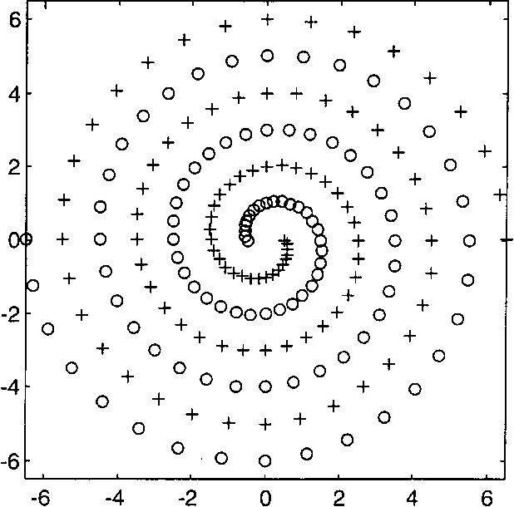
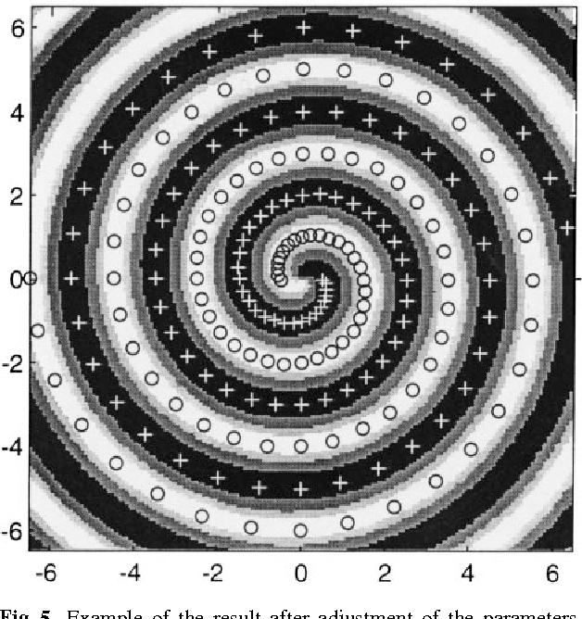
A Very Difficult Classification Problem:
Two Spirals
José R. Álvarez (1999) Injecting Knowledge into the Solution of the Two-Spiral Problem, Neural Computing & Applications DOI:10.1007/s005210050029

Slide 7
Selecting a Classifier
Data
Storage
Models
Neural
Models
Statistical
Models
Algorithmic
Models
Nearest
Neighbor
Methods
Feed-Forward
Networks
Support Vector
Machines
Softmax
Classifiers
Decision
Trees
Rule-Based
Systems
Discriminant
Analysis
Lookup
Tables
Databases
Logistic
Regression
Bayesian
Models
etc., etc….

Slide 8
Finding Class Boundaries
O
O
= A
= B
= class boundary
X
X
O
Training
Set
X
X
X
X
O
O
O
O
X
O
O
X
X
X
X
O
O
X
X
O
X
X
Feature Space
Feature space is usually a BIG place
→ The system can never see all exemplars of a class
→ It must generalize from a limited sample
The curse of dimensionality:
The number of exemplars needed to determine class boundaries
increases exponentially with data space dimension.
Reduce the dimension of data space

Slide 9
Validating Performance
O
O
O
X
O
= A
= B
= Test Set
= complicated class boundary
= better, simpler boundary
X
X
X
O
O
O
O
Training
Set
X
X
O
X
X
X
O
O
X
X
O
O
X
O
X
O
O
X
X
X
X
X
O
O
X
X
X
X
O
X
X
X
O
Feature Space
O
Fitting training data too well can be a liability
→ Go for simple inductions (Occam’s Razor)
→ Mistakes are often the price of intelligence
Intelligence requires making good choices, not perfection.
→ Know how to tell good choices from bad
(common sense, intuition, experience, wisdom)

Slide 10
Assessing the Quality of Classification
Assessing the performance of a classifier must account for two important factors:
Generalization to novel data.
The effect of class size.
Generalization is checked by validation and testing
The set of labeled data is divided into three sets:
Training Set: Used to train the classifier.
Validation Set: Used to check generalization during learning.
Test Set: Used to check generalization after learning.
Typically, the Validation and Test Sets are smaller than the Training Set,
especially if data is scarce.
More complex methods such as cross-validation are used in many cases.

Slide 12
Binary Classification Performance Metrics
Given: 1) Labeled data from two classes 0 (NO) and 1 (YES)
2) 0/1 labels assigned by a classifier to each data point
Define:
= Number of correct 0 outputs – true negatives
= Number of correct 1 outputs – true positives
= Number of 1 outputs that should have been 0 – false positives
= Number of 0 outputs that should have been 1 – false negatives
These four quantities can be used to define performance metrics for
the classifier.

Slide 13
The Most Frequently Used Metrics
Recall: Fraction of positives identified.
Indicates how much of what is true is, in fact, identified as true.
Precision:
Fraction of identified positives that are correct (how accurate are the positives?).
Indicates how much of what is identified as true is, in fact, true.
Why do we need both precision and recall?

Slide 14
Sensitivity (Recall, True Positive Rate): Fraction of positives identified.
Specificity (Selectivity, True Negative Rate): Fraction of negatives identified.
Positive Predictive Value (Precision):
Fraction of identified positives that are correct (how accurate are the positives?).
Negative Predictive Value:
Fraction of identified negatives that are correct.

Slide 15
Accuracy
Accuracy: The fraction of data that is correctly classified.
The accuracy can be misleading when the data is unbalanced, i.e., there are many more positives than negatives, or many more negatives than positives.
In that case, we can use balanced accuracy:

Slide 16
F₁ Score: Combines precision and recall into one metric.
F_{β} Score: Weights precision higher or lower than recall.
High precision indicates absence of false positives (negative seen as positive).
High recall indicates absence of false negatives (positive seen as negative).
If precision is more important, i.e., avoiding false positives is more important than missing true positives, use β < 1
e.g., choosing to invest in a startup, choosing to buy a particular car.
If recall is more important, i.e., identifying true positives is more important than avoiding false positives, use β > 1
e.g., deciding whether a person is critically ill.

Slide 17
The ROC Curve
Receiver Operating Characteristic Curve
In many binary classification problems, the classifier depends on a parameter θ,
which determines whether datapoint x is classified as C₁ or C₀. For example:
x ∈ C₁ if g(x) > θ else x ∈ C₀
As θ changes:
If we pick up more true positives
We also pick up more false positives
Perfect
Excellent
Best
Good
Poor
A good classifier should pick up the most true positives at the cost of the fewest false positives.
The area under the ROC curve (AUC) is a measure of classifier quality.
Optimal θ is where the ROC slope becomes less than 1.
True Positive Rate
(Sensitivity)
Worst
False Positive Rate
(1 – Specificity)

Slide 18
The Confusion Matrix
For multi-class problems, it is important to consider how much of data from each class is classified into each of the classes, which is represented by the confusion matrix.
Actual Class
Number of points assigned to each class
A
B
C
A
30
5
3
38
Assigned Class
7
55
3
65
B
C
22
6
43
71
59
66
49
174
Total umber of points in the dataset
Number of points actually in each class

Slide 19
Meaningful Validation
It is possible that the system may do well on both the training and testing sets, but
still not be a good model. Why????
Because the test set – which is chosen randomly – may be “easy” by accident.
How can we tell that “successful” learning is actually valid?
n-Fold Cross-Validation
Do n learning trials, choosing the training and test sets randomly each time.
Get the validation performance for each trial.
If the validation results on all (or almost all) trials are good and consistent:
The results on any of the good trials are likely to be valid → Keep the best/all.
If the validation results are good on very few trials and bad on most:
The good trials are likely flukes → This probably isn’t a good model for this task.

Slide 20
Should we expect perfect classification?
No, because we will never have complete information.
Is this imperfection a bad thing?
Of course, we would like to be correct as often as possible, but the ability to make “sufficiently correct” choices based on incomplete information is far more important.
Why?
Because it allows useful choices to be made in real time and with limited data. In a complex environment, waiting for sufficient information to make the perfect choice is unaffordable.
Intelligence does not require optimal choices, just ones that are “sufficiently good” – Satisficing (Simon)
The willingness to make errors is a “feature”, not a “bug” for an intelligent system trying to survive in a complex environment.
The preference not to make an error is also a feature.

Slide 22
Decision Theoretic Methods
Let x be an input pattern to be classified into one of m classes, C₁ ..., C_{m}
Define g₁ (x), g₂ (x), . . . , g_{m} (x)
such that
d_{ij} is the decision boundary
between C_{i} and C_{j}
The g_{i} (x) are called decision functions or discriminant functions
Example: Minimum distance classifier

Slide 23
X
X
X
X
X
O
O
O
O
O
▼
▼
▼
▼
▼
Each function is higher than all others for data within its class

Slide 24
Bayes Rule
B₁
If and
form a partition of S if:
The form
A
B₂
B₃
Note that
this
cannot be
more than
this
is widely used in estimation

Slide 25
Bayes Rule
B₁
If and
form a partition of S if:
The form
A
B₂
B₃
Note that
this
cannot be
more than
this
Likelihood
Prior
Posterior
is widely used in estimation
Evidence

Slide 26
The Bayes Classifier
Given:
Classes C₁, C₂, …, C_{m}
Data point x ∈ X
Bayes’ Rule:
Bayes Classifier: Choose class C_{i} if P(C_{i} | x ) > P(C_{k} | x) ∀ k ≠ i
g_{k} (x) = P(x|C_{k} ) P(C_{k})
because P(x) is common for all classes
Decision Function
Often, g_{k} (x) = log P(x|C_{k} ) + log P(C_{k}) is used
P(C_{k}) and P(x|C_{k} ) are estimated using the training set.

Slide 27
Suppose a satellite camera observes patches of the Earth and tries to classify
each patch based on its color as:
C₁ = Water; C₂ = Rock; C₃ = Sand; C₄ = Vegetation; C₅ = Snow/Ice
The possible observations are: x ∈ {Blue, Brown, Yellow, Green, White}
Suppose the observation is x = Green
What is the probability that the patch is Water?
Prior: How likely is it that a random patch on the Earth is Water? – say 0.75 = P(Water)
Likelihood: Given that a patch is Water, how likely is it to be Green? – say 0.1 = P(Green | Water)
Evidence: How likely is it that a random patch on the Earth is Green? – say 0.2 = P(Green)
With these values P(Water | Green) = (0.1)(0.75)/0.2 = 0.375
Note that, given the first two probabilities, the third cannot be chosen arbitrarily. For example, we cannot have
P(Green) = 0.05, because if Green Water has a probability of 0.75×0.1 = 0.075, even if all Green is Water, its
probability cannot be less than 0.075. If some of the Green is not Water, its probability must be higher.

Slide 29
Three Simple Classifiers

Slide 30
Minimum Distance Classifier
(Minimum Distance to Mean Classifier)
Let class centroids be
Note that x^{k} and u^{i} are n-dimensional vectors,
where n ≡ dimension of the feature space
N_{i} = # of patterns of class i in the training set.
Given a test pattern, x
We assign it to the class whose centroid it is closest to.
http://homepages.inf.ed.ac.uk/rbf/HIPR2/classify.htm

Slide 31
Define distance from centroid as:
where
(Euclidean norm)
so:
1.
2.

Slide 32
Our hypothesis is
i.e. we need to find the smallest D_{i} (x)
are decision functions for i = 1, …, m
Perpendicular bisector of the two centroids

Slide 33
Example:
Given patterns
Training set
x₁ | x₂ | y
10 | 10 | 0
4 | 3 | 1
11 | 12 | 0
3 | 2 | 1

Slide 35
Decision boundary:
x³
X
x¹
X
X
u¹
x₂
x²
O
O
u²
O
d₁₂
x⁴
x₁

Slide 36
Critique of MDC’s
A. Pairs of classes must be linearly separable – since d_{ij} is a line
✓
✗
X
X
X
X
X
X
X
X
X
X
X
f₁
f₁
O
X
X
X
X
O
O
X
X
O
O
X
O
O
O
X
X
O
O
O
O
O
O
O
O
O
O
O
O
f₂
f₂

Slide 37
B. MDC’s work best when patterns in each class are distributed in a
“spherical hypercloud” around the class mean.
X
X
X
X
X
X
X
X
X
X
X
X
X
X
X
X
X
X
X
X
X
X
X
X
X
X
X
X
X
X
X
X
X
✓
✗

Slide 38
C. MDC’s can have problems if nearby classes have very different spreads
X
X
X
X
X
X
X
X
X
X
X
X
X
X
X
X
X
X
X
X
X
X
X
X
X
X
X
X
X
X
X
X
X
X
X
X
X
X
X
X
X
X
X
X
X
X
X
X
X
X
X
X
X
X
X
X
X
X
X
O
O
X
X
O
O
X
X
X
O
O
Inferred
Decision
Boundary
Ideal
Decision
Boundary

Slide 39
D. Outliers can cause problems for minimum distance classifiers
Misclassified outliers
X
X
X
X
X
X
X
X
X
X
X
O
O
O
O
O
O
In general, it should not be possible for exemplars of class i to be closer
to some u^{j} , j ≠ i than to u^{i}
Note that in this case, the classes are linearly separable, but the classifier
still makes errors.

Slide 40
E. Like most classifiers, minimum distance classifiers work well if
interclass distances are large compared to class spreads.
X
X
X
X
X
X
X
X
X
O
X
X
X
X
O
O
O
O
O
O
X
O
O
O
O
O
O
Well-separated classes
Cutting it close – new data may
fall on the wrong side.

Slide 41
The minimum distance classifier is a Bayes classifier with the
following assumptions:
All classes have Gaussian (normal) distributions.
All classes have the same variance.
All classes have diagonal covariance matrices (features are independent).
All classes have the same prior probability of occurrence.
If some of these assumptions are not true, the classifier fails, and a more complicated classifier must be used.
For example, a quadratic classifier:
where K_{i} is the covariance matrix of features in class C_{i}

Slide 43
The k-Nearest Neighbors (KNN) Classifier
X
X
X
X
X = Class A
O = Class B
5 nearest neighbors
→ 3A 2B
→ + is classified as A
X
O
O
O
X
X
O
X
+
O
O
O
O
O
O

Slide 44
Pros and Cons of KNN
Pros
Cons
Very simple to implement.
Makes intuitive sense.
Requires no optimization
or training (at least in this
simple form).
Easy to use.
Can handle nonlinearly
separable classes.
Class boundaries are implicit,
i.e., not explicitly defined by
an equation as in MDC.
Outliers can lead to poor
results.

Slide 46
The Perceptron
x₀ = 1
w_{i1}
w_{i0}
x₁
Net
Input
w_{i2}
Σ
x₂
s_{i}
f
y_{i}
Input
w_{i3}
Output
x₃
w_{in}
Activation Function
x_{n}
Composition Function
f (s)
1
0
s
The perceptron is a Linear Threshold Unit (LTU)

Slide 47
2-Dimensional Case
1
w_{i0}
Decision Boundary:
x₁
w_{i1}
x₂
w_{i2}
x₂
x₁

Slide 48
Perceptron Decision Boundary
The perceptron is a linear classifier. It can draw any linear boundary in feature space.
X
X
X
X
X
X
X
X
X
X
X
X
X
X
X
X
X
X
X
X
X
X
X
X
X
X
X
X
X
X
X
X
X
X
X
X
X
X
X
X
X
X
X
X
X
X
X
X
X
X
X
X
X
X
X
X
X
X
X
O
O
X
X
O
O
X
X
X
O
O
Minimum Distance
Classifier Decision
Boundary
Perceptron
Decision
Boundary

Slide 49
The Perceptron Learning Rule
Basic Approach

Slide 50
Algorithm
Possible stopping criteria:
- All inputs classified correctly
- A time limit is reached
η is called the learning rate

Slide 51
Why it works….
δ
> 0
Case 1
Case 2

Slide 52
A bad initial boundary
It is very important to choose:
The right initial weights.
An appropriate learning rate.
A good initial boundary
Learning rate should generally be small to avoid overshoot and oscillation…..
……. but this only works if the initial boundary (= weights) is chosen well.
o
o
o
o
o
x
x
x
o
x
o
x
x
o
x

Slide 53
Multiple Output Case
1
x₁
1
y₁
Output vector
x₂
2
y₂
x_{n}
l
y_{ι}
⇒ Each perceptron can be trained separately and simultaneously using the perceptron algorithm without interactions.

